Slide 1





Annalist (“keeper of records”)
Graham Klyne
e-Research Centre, University of Oxford

Slide 2


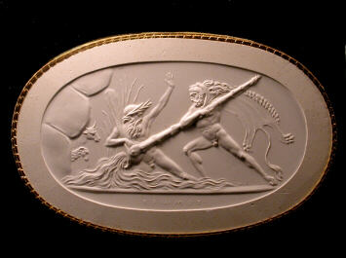
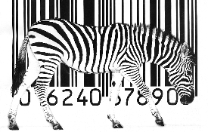
Acknowledgements
OeRC: FAST project (digital music)
Kevin Page, David Weigl, David De Roure, Terhi Nurmikko-Fuller, Alan Chamberlain, Steve Benford, et al
JISC RDS: CREAM project (active metadata)
Cerys Willoughby, Simon Coles, Colin Bird, Iris Garrelfs, Athanasios Velios, Mike Mineter, et al
Wf4Ever (research objects, workflows)
Jun Zhao, Kevin Page, David De Roure, Stian Soiland-Reyes, Sean Bechhofer, Khalid Belhajjame, Carole Goble, Daniel Garijo, Oscar Corcho, et al
OeRC: Claros project (classical art)
Donna Kurtz, Robert Kummer, Reinhard Förtsch, et al
Oxford (Zoology): IBRG (image bioinformatics)
David Shotton, Jun Zhao, Alistair Miles, Helen White-Cooper, et al
Notes:
Annalist is a project that has been in gestation over many years, and the ideas behind it have been informed by many past and present projects, and people I’ve worked with, a few of whom are listed here. There are surely many others whose thoughts have permeated the Annalist designs, for whose omission I must apologize in advance.

Slide 3
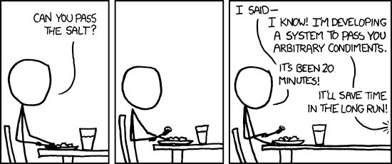
Origins
https://xkcd.com/974/
Notes:
One of the early seeds for the project that became Annalist was planted over 15 years ago, at the conference dinner for the 1999 Semantic Web symposium in Stanford. The second RDF working group was active at about this time. I happened to be sitting at the same table as Prof Jim Hendler, who made a comment to the effect that what was really needed to help the semantic web gain traction was to have more RDF data on the web. At that time, DARPA funded projects were working to put large scale datasets like the CIA World Factbook on the web as RDF. In contrast with this, my focus has been on personal and small-scale data, and dealing with its attendant diversity.
Since then, I've made a couple of failed attempts to implement a generic web-based system for small-scale creation of linked data. But more recently, with the aid of better tools, and starting with more modest goals, I have managed to develop Annalist as a working tool.
I just hope that nobody's been waiting over 15 years for me to pass the salt.

Slide 4
Goal
To make it quick and easy for individuals and small teams to create and share linked data on the web
Notes:
My overall goal in creating Annalist has been to make it quick and easy to create and share linked data on the web.
Working on a range of research projects over the past 10 years or so, covering bioinformatics to classical arts, I've found the level of effort needed to create robust tools for working with linked data to be an impediment to deploying applications for research users. I feel this lack of tools has put use of linked data beyond the reach of many small research groups who might benefit from facilitated exchange of data with a wider community of peers.
I’ve also wanted to create something that would it easy for me to prototype ideas for applications using RDF.
And I am interested in the idea that tools for manipulating RDF should themselves use RDF, in a kind of self-maintaining fashion.

Slide 5
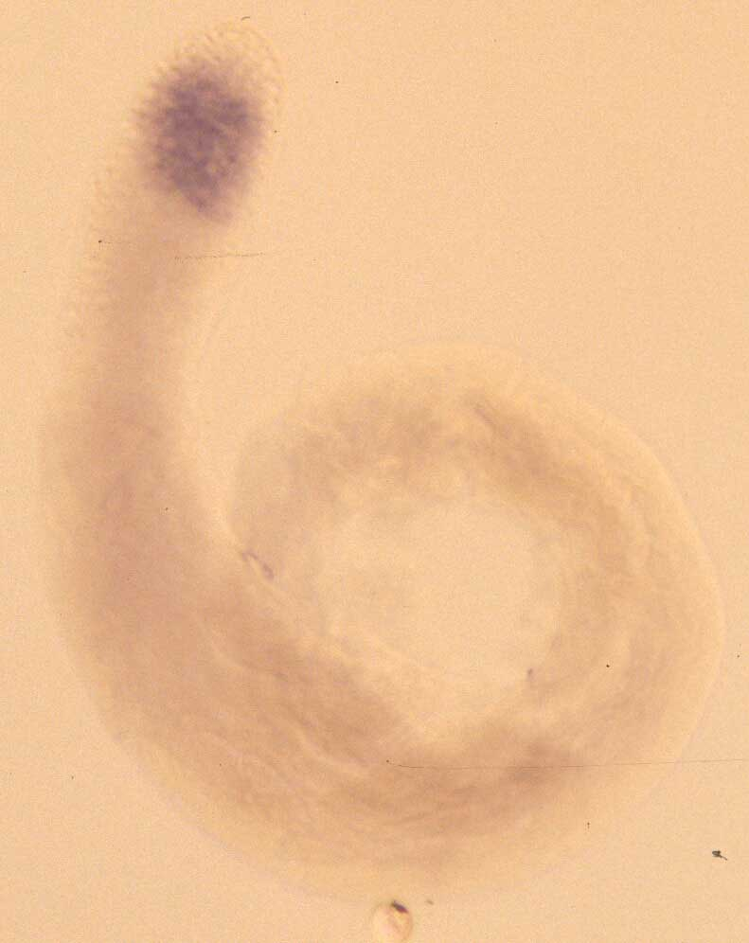
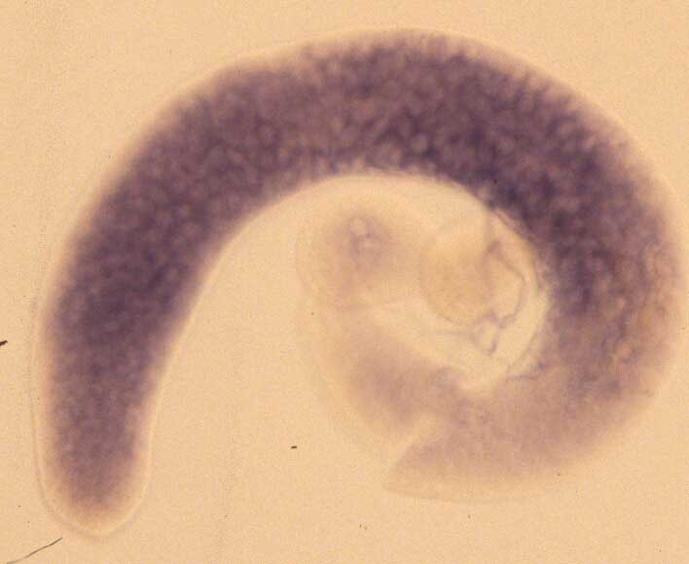
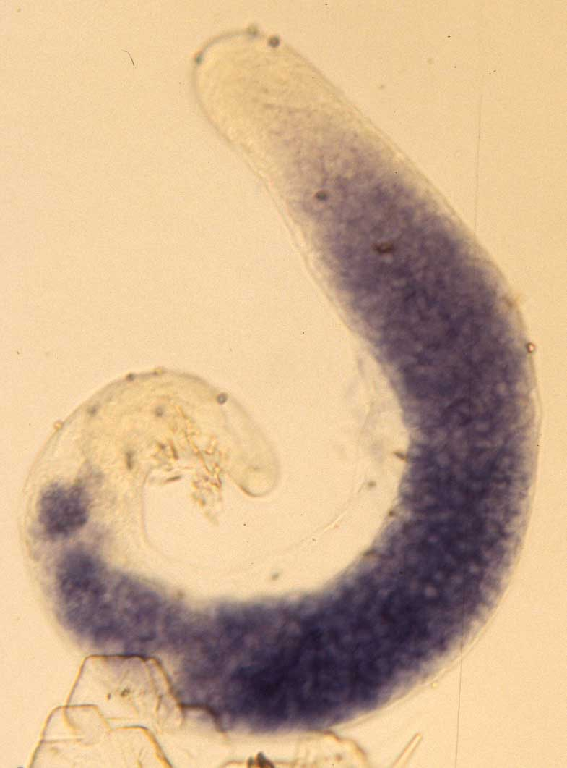
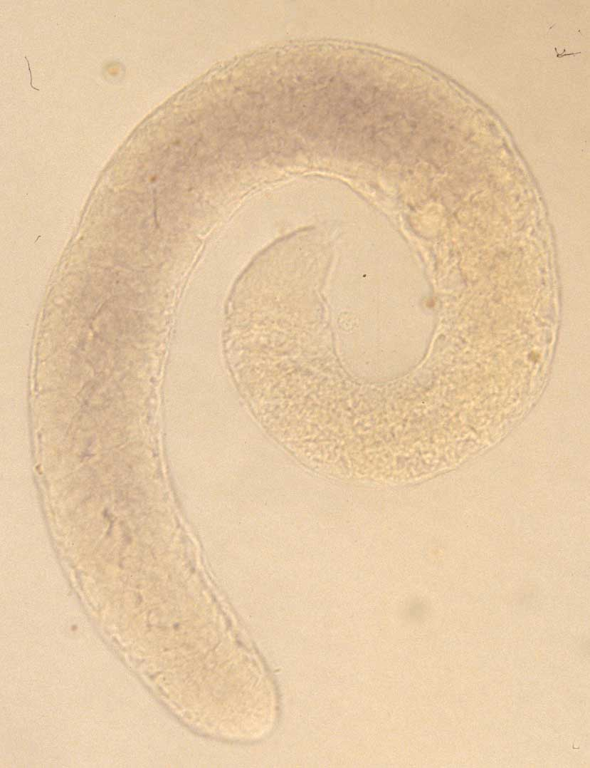
Example: Fly-TED
To an expert observer these images clearly show gene expression at different stages of spermatogenesis
Each image corresponds to a different combination of gene and a strain of Drosophila melanogaster (fruit fly)
These in situ hybridization images are the final result of a complex experimental process
Reproducibility and interpretation require that the preparatory steps are recorded along with the images and annotations
CG2247 wt
CG2247 topi
CG12907 aly
CG12907 topi
Images: Dr Helen White-Cooper
Notes:
Here is an example of the kind of project that has informed requirements for Annalist.
I was working in Oxford’s Zoology department with a genomics research team, who were creating a database of gene expression images that showed the activity of different genes at different stages of sperm development in fruit flies.
This database was intended to become a community resource for researchers, to sit alongside several other public resources on the web.

Slide 6
Example: Fly-TED data flows
Import
Wet-lab preparation,
observation and annotation
Publish
Notes:
The diversity of data and activities that went into creating these gene expression images is illustrated here.
The process of preparation, capture and annotation involved many stages, and many kinds of related data, including published literature and data sources, statistical analysis, wet-lab work and microscopic observation.
This work resulted in a published database, and was reported in the Nucleic Acids Research journal. Unfortunately, the database became inoperable due to a virtual machine infrastructure failure. Although the original raw data still existed, lack of available effort to rebuild the customized platform has meant the published data are no longer available on the web.

Slide 7
Requirements
R1: Ease of use: quickly create a simple collection
R2: Ease of use: no programming or HTML coding
R3: Ease of use: no knowledge of RDF and/or OWL
R4: Flexibility: choice of RDF vocabulary used
R5: Flexibility: define or adapt structure of data
R6: Sharability: including online access and offline copying
R7: Remixability: linkable, use domain vocabularies
R8: Portability: move data between systems; not centralized
R9: Sustainable software: use unmodified software
R10: Sustainable of data: standard, easily used format
R11: Exposed data: accessible to independent software
R12: Offline working
Notes:
These sustainability travails with Fly-TED gave rise to several requirements that have informed the design of Annalist.
I don’t intend to discuss them all individually (they are covered in the workshop paper), but the general drift is towards ease-of-use, flexibility, and sustainability of data.
(pause)

Slide 8
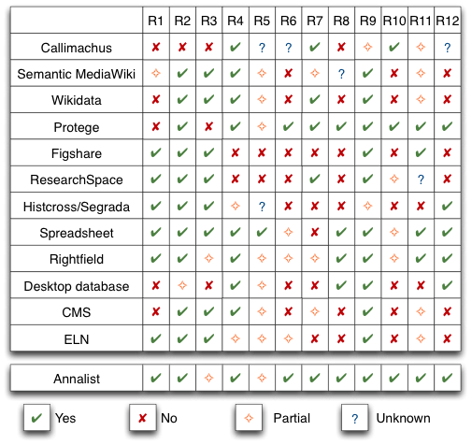
Survey
Notes:
A survey of existing tools for creating and sharing linked data indicated that the identified requirements are all addressed by some tool or other, but not all together in any single tool that we could identify.

Slide 9
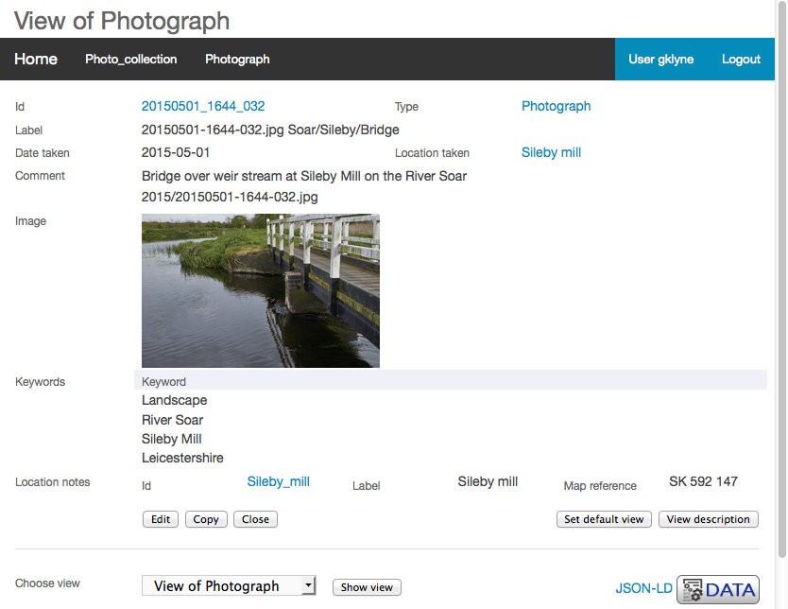
Annalist example (view)
Notes:
So what does Annalist look like in use?
This, and the following screenshots are taken from the Annalist tutorial, which uses Annalist to create a catalogue of photographs and associated metadata.
It shows a view of data describing a photograph, as presented by Annalist.
Note how the presentation combines free-form textual description, structured annotation, image media, and references to other entities.

Slide 10
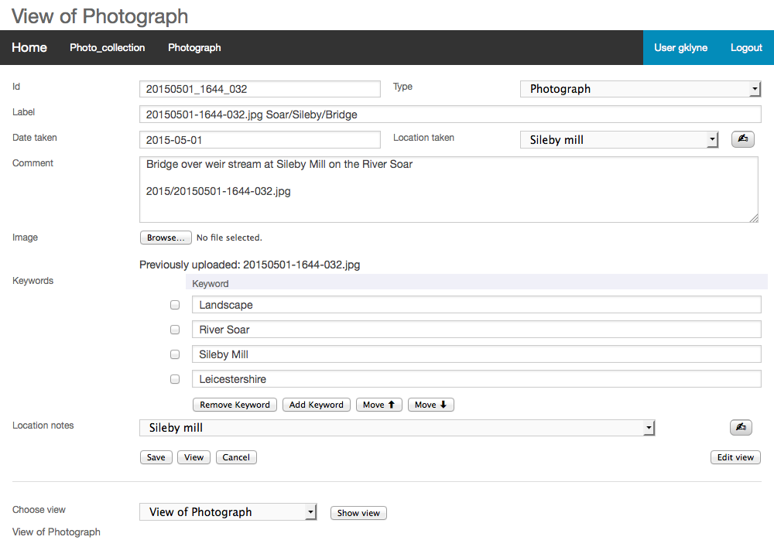
Notes:
This screenshot shows the same data presented in a form used to create and edit the data.

Slide 11
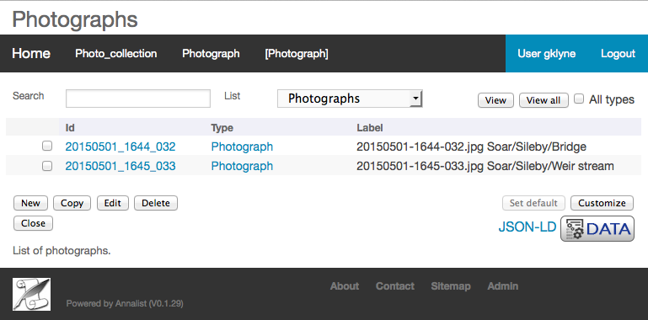
Data:
http://demo.annalist.net/annalist/c/Photo_collection/
Tutorial:
http://annalist.net/documents/tutorial/annalist-tutorial.html
Notes:
And, finally, this is a view that shows a list of photographs for which there is data in the containing collection.
These three screenshots exemplify three main kinds of display provided by Annalist:
1. data display, used for viewing entity data
2. editing form, used for creating and updating entity data
3. entity list, used for browsing and navigating the contents of a collection
The example data and the Annalist tutorial can be found at the links shown.

Slide 12
Design philosophy
Data first, structure later
Minimize impediments to data entry
Annalist as a part in a wider linked data ecosystem
JSON-LD as “view source” for linked data
Open source, open development
The message that data can tell is not always clear at the outset, but may emerge though the process of observation and collection.
Notes:
Turning now to the design and implementation of Annalist...
The philosophy adopted in the design of Annalist tends to favour flexible data entry over conformance to formal schema and ontologies in the acquisition of data.
But the design is intended to allow for formal structures to be crystallized (using new or existing ontologies)
as the underlying message that data conveys becomes more apparent through its acquisition.
Annalist maintains data in a format that is accessible to other applications, rather than trying to be a one stop shop for every possible need.

Slide 13
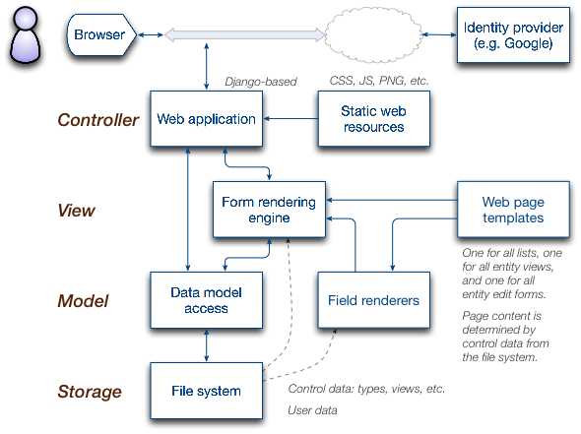
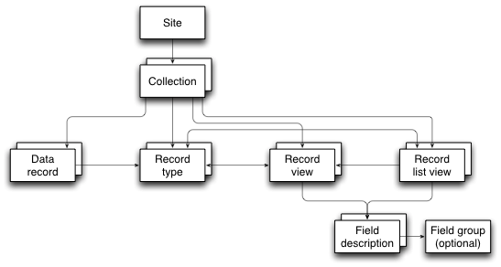
Technical design
Web server application
Data stored as JSON-LD files
Can be published by any HTTP server
Customizable form generator
Definition as JSON-LD, also managed by Annalist
One definition used for view and edit forms
Notes:
Annalist is implemented as a web server application. It can be deployed in different environments (desktop, local workgroup server or data centre), and has been used in each of these deployments.
There are also Docker containers available from DockerHub.
Application logic is implemented server-side, with some browser-based Javascript used for responsive user interface and some enhanced interactions.
(move on...)

Slide 14
Technical design
Web server application
Deployable in desktop, workgroup or cloud
(Docker too)
Main logic is server-based
Javascript for responsive interface
Data stored as JSON-LD files
Can be published directly by HTTP server
Customizable form generator
Definition as JSON-LD, also managed by Annalist
One definition used for view and edit forms
Notes:
Annalist is implemented as a web server application. It can be deployed in different environments (desktop, local workgroup server or data centre), and has been used in each of these deployments.
There are also Docker containers available from DockerHub.
Application logic is implemented server-side, with some browser-based Javascript used for responsive user interface and some enhanced interactions.
(move on...)

Slide 15
Notes:
The Annalist server is implemented in Python using the Django web application framework.
It makes minimal use of Django’s built-in database facilities, but instead stores data as JSON-LD files – currently in the server file system, but with plans for using external HTTP servers in the future.
At its heart is a customizable form generator, used to display data views, editing forms and lists of entities, combining editable definitions and user data records.

Slide 16
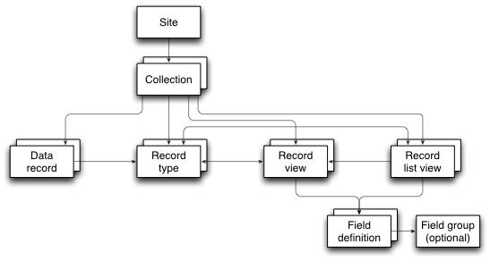
Data model concepts
Notes:
The data model is built around a number of conceptual elements:
Each Annalist deployment is associated with a Site, which generally corresponds to a single server machine (or container).
An Annalist site may contain any number of data Collections, which may be free-standing, or may use definitions from other collections in the same site. Definitions and data associated with a collection are stored in a single container directory, which may be copied or moved across systems.
Within a collection, entities are described by Data records, whose content and structure are controlled by Record types, Record Views, Record list views and Field definitions, which are themselves data records.
(Some Field definitions refer also to a Field group.)
Record types are used mainly as a way of organizing entities into broad categories, and do not of themselves define the content the corresponding data records.
Rather, the *content* and internal structure of data records is defined by the view or views that are used to create and/or edit them.
The association between types and views is quite loose, and a single view may be used with several different types, or different views may be used with a single type.

Slide 17
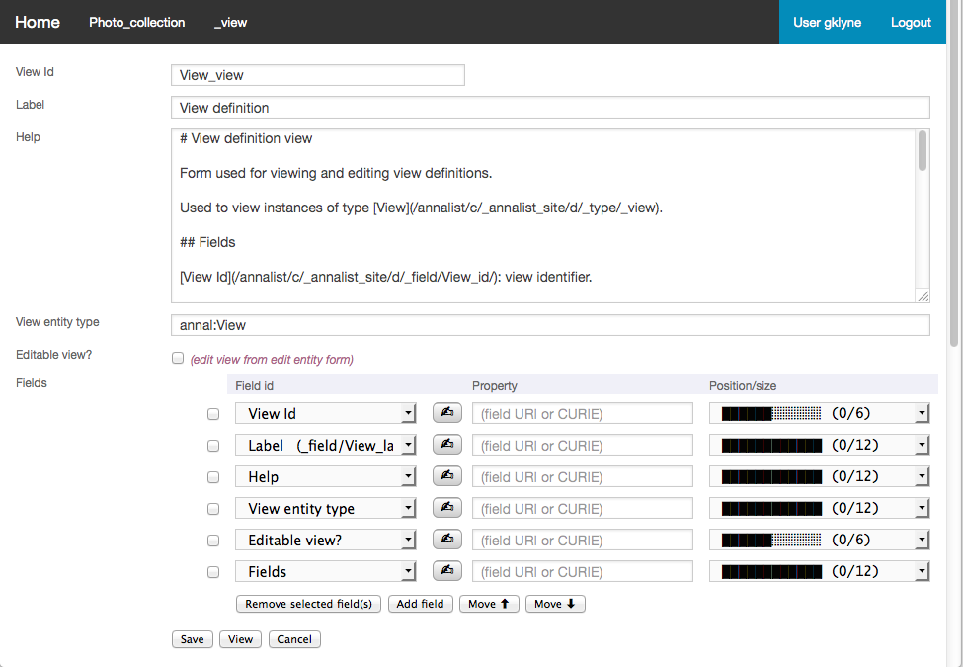
Configuration self-maintenance
Notes:
The internal Annalist definitions for types, views, etc., are themselves all viewable (and editable) as Annalist data records.
Just for fun, this screenshot shows the definition of the view that is used for displaying and editing view definitions.
So what you see here is defining its own presentation.
A close look reveals that the fields displayed in the view (“View Id”, “Label”, etc.) are reflected in the list of fields that are referenced by the view definition.
And...

Slide 18
JSON-LD as “view source” for data
{ "@id": "annal:display/View_view"
, "@type": ["annal:View"]
, "@context": ["../../coll_context.jsonld"]
, "annal:id": "View_view"
, "annal:type_id": "_view"
, "annal:uri": "annal:display/View_view"
, "annal:record_type": "annal:View"
, "rdfs:label": "View definition"
, "rdfs:comment": "# View definition view\r\n\r\nForm used for viewing ...
, "annal:open_view": false
, "annal:view_fields":
[ { "annal:field_id": "_field/View_id"
, "annal:field_placement": "small:0,12;medium:0,6” }
, { "annal:field_id": "_field/View_label"
, "annal:field_placement": "small:0,12” }
, { "annal:field_id": "_field/View_comment"
, "annal:field_placement": "small:0,12” }
, { "annal:field_id": "_field/View_target_type"
, "annal:field_placement": "small:0,12” }
, { "annal:field_id": "_field/View_edit_view"
, "annal:field_placement": "small:0,12;medium:0,6” }
, { "annal:field_id": "_field/View_fields"
, "annal:field_placement": "small:0,12” }
]}
Notes:
[And...]
... this is the JSON-LD that is stored for the view definition shown previously.
My experience as a developer has been that JSON-LD sits in a sweet spot between machine processable and human readable and editable data, which has been a key benefit for bootstrapping the Annalist system definitions.
It offers a good “impedance match” with programming language data types for manipulating data (arrays, dictionaries, etc.)
And it also avoids some of uglier aspects of working directly with the RDF model (e.g. dealing with lists).

Slide 19
Progress to date
A viable tool to create and share linked data
Flexible to deal with diverse applications
Robust
even as a work-in-progress, I have never lost application data due to an Annalist software fault
At least approachable for users who are not familiar with RDF
Notes:
Annalist is an ongoing project ... so what has been achieved so far?
I think I can claim:
it’s a viable tool for creating and sharing linked data,
which is sufficiently flexible to be usable in diverse applications, and
robust enough to be trusted with users’ data.
Experience to date indicates that Annalist is at least approachable for users who are not steeped in RDF lore.
But...

Slide 20
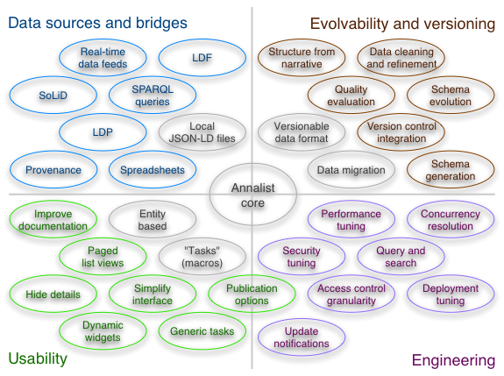
Status and future work
Notes:
[But...]
... there remains plenty to do, which is the message of this rather busy diagram.
I don’t propose to describe all of these, but they roughly divide into the areas shown:
[Data sources and bridges]
In the blue corner, we have... ability to work with alternative storage and data from a variety of sources. (e.g. working with existing data provided as spreadsheets).
[Usability]
In the green corner... making Annalist easier to use, especially in the area of defining structure and presentation of data
[Evolvability and versioning]
In the brown corner: improving capabilities for dealing with evolving data and schemas
[Engineering]
And finally... engineering improvements to performance, security and other capabilities
A number of these areas (the ones coloured grey on theslide) are already being addressed.
I would point out that, given Annalist is intended to operate as a part of a suite of tools for handling linked data,
not all of these functions should necessarily be part of Annalist itself.
For example, publication options and quality evaluation are features that I feel can be addressed by generic linked data tools used in conjunction with Annalist.

Slide 21
Transition to community project
A public repository is a start:
https://github.com/gklyne/annalist
MIT licence
But there remain many things to do...
Governance
Supporting documentation
Engage other developers
Integration with complementary systems
Application data definition “libraries”
Notes:
In addition to the various technical issues mentioned, there is the goal of transition to a community project.
Annalist has, from the outset, been an open development. All source code, documentation and design notes have been maintained in a public repository, but...
Assuming that there will be others who may find Annalist useful, one of my goals for the coming year is to start the transition from an “open source” project with a single developer to a wider community project.

Slide 22
Discussion
Ontologies optional (schema follows data)?
Locators and Identifiers (local vs global names)?
Evolution and versioning: in/of data? Git or PROV?
Primacy of source (JSON) over data model (triples)?
Some issues raised by paper reviewers:
Evolution: data or schema
Concurrent access conflicts
Access control granularity
Usability, evaluation
Flat file storage performance
Notes:
This concludes what was intended to be the “linear” part of my presentation of Annalist.
and I hope that there remains time for discussion of issues arising.
This slide highlights some points raised in discussions with colleagues, and by the paper reviewers for this workshop.
I’d be happy to engage in discussion of these or any other questions.
(and if no questions, I can plough on???)

Slide 23
Links
Paper
https://github.com/gklyne/annalist/blob/develop/documents/publications/LDOW2016-paper/ Annalist-paper-ACMSIG.pdf
Slides
https://github.com/gklyne/annalist/blob/develop/documents/publications/LDOW2016-paper/ annalist-presentation-ldow2016.pptx, .pdf
Demo site
http://demo.annalist.net/
Tutorial
http://annalist.net/documents/tutorial/annalist-tutorial.html
Software
https://github.com/gklyne/annalist/

Slide 24
Evolvability
Recall: data first philosophy
Two aspects of evolution:
adding structure to data (add schema)
changing existing structure (schema change)
Types vs properties:
using Annalist, types primarily affect resource naming (entity names)
properties affect content (JSON keys)
Notes:
(Spare slide to support possible discussion)

Slide 25
Data migration
Focus on type and property URI changes
Adopting a guided approach for now
$ annalist-manager migratecollection Performance_defs Journal_defs
# Migration report from collection 'Performance_defs' to 'Journal_defs' #
* Type Uploaded_audio, URI changed from 'coll:Uploaded_audio' to 'coll:Uploaded_audio_test’
Consider adding supertype 'coll:Uploaded_audio' to
type 'Uploaded_audio' in collection 'Journal_defs’
URI 'coll:Uploaded_audio' appears as entity type for view 'Uploaded_audio’
URI 'coll:Uploaded_audio' appears as entity type for list 'Uploaded_audio’
URI 'coll:Uploaded_audio' appears in selector for list 'Uploaded_audio’
URI 'coll:Uploaded_audio' appears as entity type for group Uploaded_audio_m
URI 'coll:Uploaded_audio' appears as entity type for group Uploaded_audio_r
* Field Linked_audio, property URI changed from 'coll:audio_clip' to 'coll:linked_audio’
Consider adding property alias for 'coll:audio_clip' to type Linked_audio in collection 'Journal_defs'
* Field Web_resource, property URI changed from 'coll:web_resource' to 'coll:resource'
Consider adding property alias for 'coll:web_resource' to type
Web_resource in collection 'Journal_defs’
Notes:
(Spare slide to support possible discussion)

Slide 26
Concurrent access conflicts
Atomic updates to single entity
Design to detect update conflicts:
detect changes while an edit is in progress
cf. HTTP entity tag (ETag)
not currently implemented
No consistency checks between entities
storage model doesn’t care about consistency
consider as aspect of data quality checks
handle post-acquisition, as needed
Notes:
(Spare slide to support possible discussion)

Slide 27
Access control granularity
Currently:
control applied per-collection
permissions associated with authenticated user Id in Annalist “user permissions” record
limited possibility to require different permissions for different record types
Possibilities:
type-based permission requirements could offer finer granularity (but not to individual statement level)
Generalize Annalist trust/permission model for RBAC
Would like:
To devise way to use OpenID Connect (OAuth2) authentication with WebID permissions; e.g. to work with SoLiD servers
Notes:
(Spare slide to support possible discussion)
# Access control notes
Currently permission records are stored as Annalist linked data records, so in principle could be referred to externally served resources.
I did look at UMA ~2 years ago, but at the time its requirements conflicted with Annalist goals.
Issues:
- granularity - currently per collection, with limited per-type (e.g. User Permissions access requires ADMIN)
- role-based - currently directly associated with authenticated user id, no provision for roles
- trust model - currently trust local user permission records
- SoLiD servers - how to combine OpenID connect with WebID?

Slide 28
Usability, evaluation
No formal usability study (yet)
What to test?
Different user applications are ... different
How to formally test flexibility?
Evolving interface through experience
Incremental development, informed by “agile”
Using Annalist in diverse applications
Modifying user interface in response to problems experienced
Notes:
(Spare slide to support possible discussion)
I’m not sure that it’s a valid alternative to formal usability studies, but my approach has been to create minimum sufficient functionality for a task, and then to build on that incrementally. In some sense, usability evaluation is built in to the development process (but not formally recorded).
The “Chemistry personas” collection was developed in Annalist by a researcher not intimately familiar with RDF, but with detailed experience of experimental procedures in chemistry.
See: http://cream.annalist.net/annalist/c/Chemistry_Personas/d/type_Plan/plan_Synth_01/
I have noticed that the interface sometimes lends itself to appropriation – I’ve had required features on my TODO list, only to realize later on that I can implement them using existing capabilities (e.g. unified image link/import/upload fields.)
Discuss... ?

